Slide 1















Writing Across
all
Content Areas

Slide 2
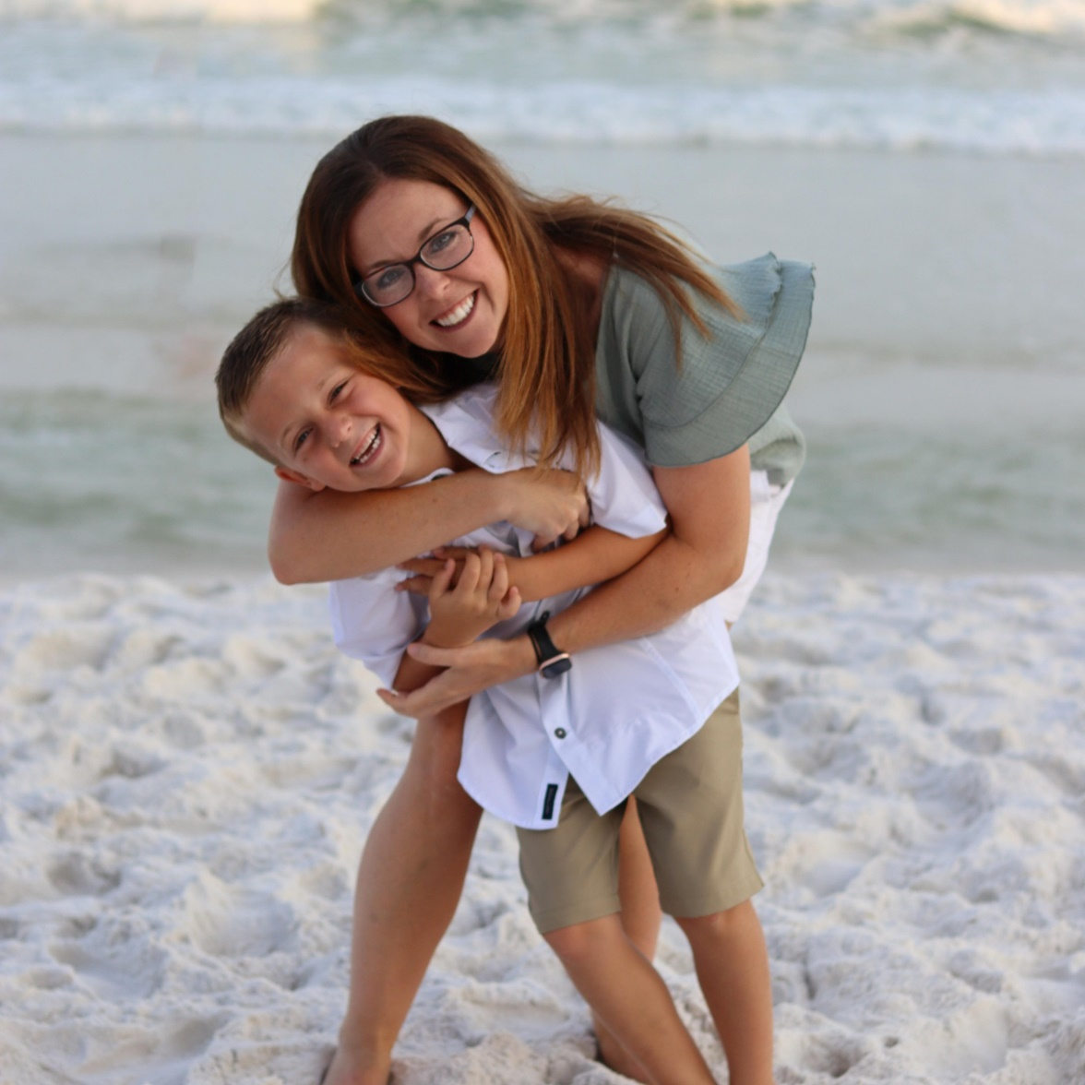
Introduction
Cassidy Crawford
Hooks Elementary
crawfordca@hooksisd.net
Hi there! I’m Cassidy!

Slide 3
“Reading and writing are like inhaling and exhaling; they cannot be separated.”
- Gretchen Bernabei

Slide 4
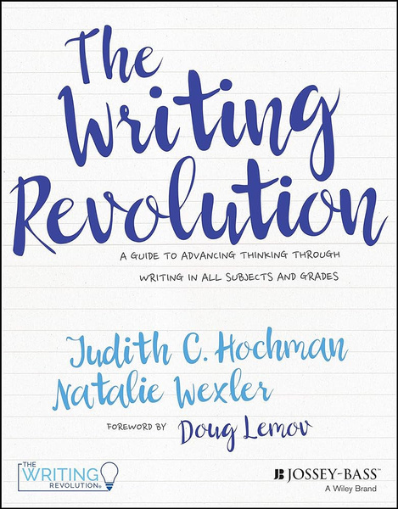
Because
01.
explains why something is true
But
02.
indicates a change of direction (similar to a U-turn)
An easy strategy across ALL content areas!
So
03.
tells us what happens as a result of something else - in other words, a cause and its effect.

Slide 5
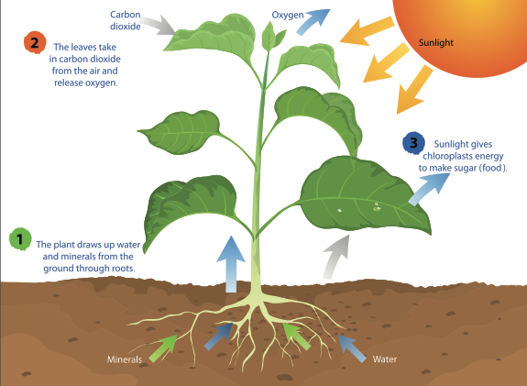
Science Lesson
Posed Question:
Why do seeds need light to grow?

Slide 6
Sentence Stem:
Seeds need light to grow .
Student response:
Seeds need light to grow because .
Seeds need light to grow, but .
Seeds need light to grow, so .

Slide 7
Level 1-practice orally before writing it!
Level 1-may only focus on one conjunction at a time.
Sentence Stem:
The teacher was happy .
Student response:
The teacher was happy because we raised our hands.
The teacher was happy, but she still gave us homework.
The teacher was happy, so she gave us a longer recess.

Slide 8
Use newly introduced vocabulary or spelling words!
Sentence Stem:
The critic thought the restaurant was mediocre
Student response:
The critic thought the restaurant was mediocre, because the menu was limited.
The critic thought the restaurant was mediocre, but others believed it was excellent.
The critic thought the restaurant was mediocre, so he rated it 3 stars instead of 5 in his review.

Slide 9
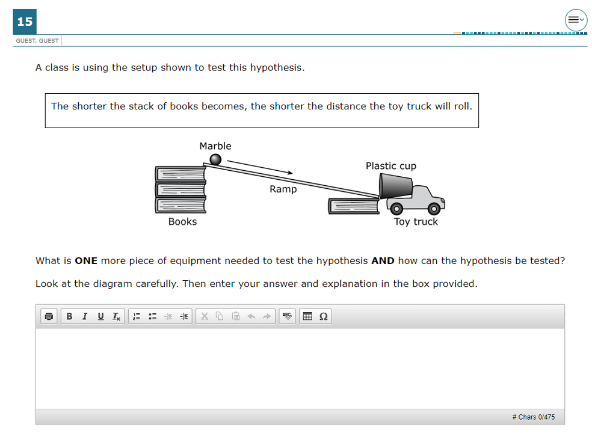

  Examine
5th Grade Science

Slide 10
The shorter the stack of books becomes, the shorter the distance the toy truck will roll .
The shorter the stack of books becomes, the shorter the distance the toy truck will roll because the pulling force becomes less.
The shorter the stack of books becomes, the shorter the distance the toy truck will roll, but to make it roll further the height of the stack needs to increase.
The shorter the stack of books becomes, the shorter the distance the toy truck will roll, so they height of the books affects the distance the truck will travel.

Slide 11
Cleaning up welds is important prior to painting .
Cleaning up welds is important prior to painting because the judges expect a show project to be as free of imperfections as possible.
Cleaning up welds is important prior to painting, but be realistic and understand that it is not possible to catch every bb.
Cleaning up welds is important prior to painting, so be sure to factor in time for this task in your project time.

Slide 12


Make sure your students understand the meanings of each conjunction.
A sentence stem must be a complete sentence.
Be sure to anticipate student’s responses.
Ensure students have enough content knowledge to complete the activity.
Not every text will lend itself to using all three conjunctions.
Take Note!

Slide 13

Because
01.
explains why something is true
But
02.
indicates a change of direction (similar to a U-turn)
The dung beetle is fascinating_______________.
So
03.
tells us what happens as a result of something else - in other words, a cause and its effect.

Slide 14

Because
01.
explains why something is true
But
02.
indicates a change of direction (similar to a U-turn)
Build your own!
So
03.
tells us what happens as a result of something else - in other words, a cause and its effect.

Slide 15
I like to go to the beach __________.
People should reduce, reuse and recycle __________.
The band is an important part of the pep rally __________.
The sun is a major source of energy in the water cycle __________.
The Louisiana Purchase as a pivotal event in American history __________.
The two fractions are equivalent __________.
Developing good exercise habits early in life is critical __________.
The quarterback must read the defense before the ball is snapped __________.
I would like to meet an alien __________.
Abraham Lincoln was a great president __________.
I love to run __________.
Cross-contamination during food preparation must be prevented __________.

Slide 16
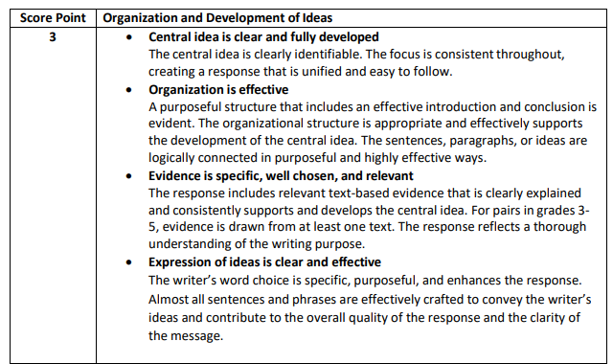
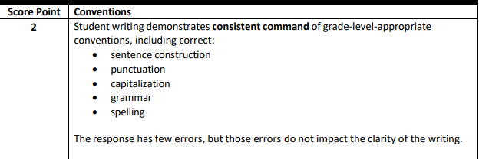
Scoring Guide
STAAR RLA Resources

Slide 17
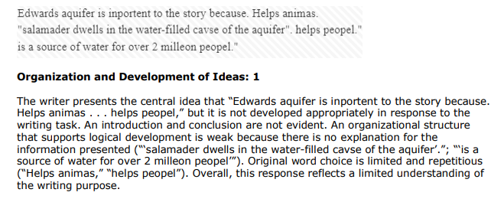

Student Response
= Score of 2

Slide 18
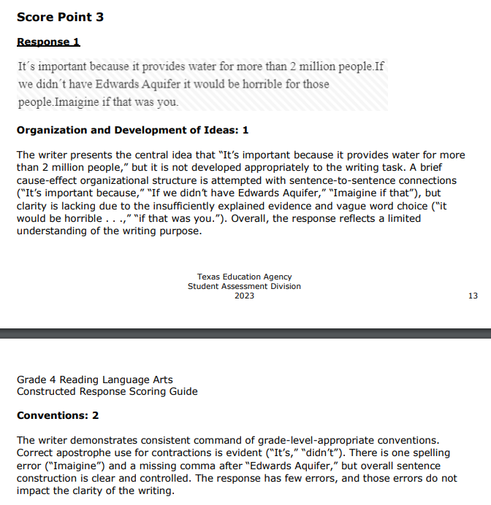
Student Response
= Score of 6

Slide 19


Extended Construction Response (ECR)
This combination contributes to the body of the ECR.
Constructed Response
Because statements become the foundation for the answer - and students simply add their relevant textual evidence.
It is a process!

Slide 20
How can you support this effort?
Address during PLCs
  Complex texts - Is this text complex and why are we using it?
  Discussion about content - What questions will we pose to students?
  Tier 1-level questions aligned with grade-level specificity - How will we build up to the difficulty level of Bloom’s to match the TEKS?
  Text-based responses -
verbal - What should I expect to hear from students in the classroom?
written - Have we created exemplars for this writing task?
For your Because, But, So....
  Insist upon correct capitalization and punctuation.
  Insist upon complete sentences and pertinent academic vocabulary.
Reading - Speaking - Writing are all centered around the text/learning

Slide 21
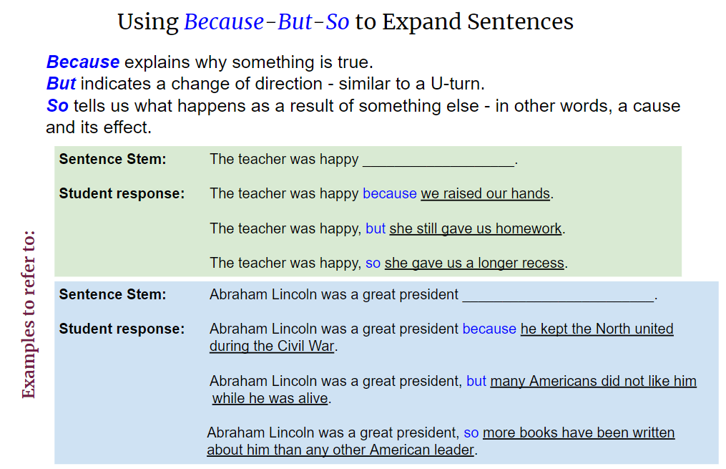
Writing Revolution Poster

Slide 22
Thank you very much!

